Slide 1
CAPSTONE PROJECT: HEALTHCARE FRAUD DETECTION
Presenter: QAISARA MARDHIAH BINTI ROSLAN

Slide 2
INTRODUCTION
PROBLEM STATEMENT:
Detecting healthcare fraud is a complex task due to the evolving tactics used by fraudsters. The problem is to develop an effective healthcare fraud detection system using a Supervised Learning model that can identify fraudulent activities within healthcare claims and transactions.
OBJECTIVES:
Develop a system capable of identifying a wide range of fraudulent activities within healthcare claims.
Utilizing supervised learning models and algorithms to enhance the accuracy of fraud detection.

Slide 3
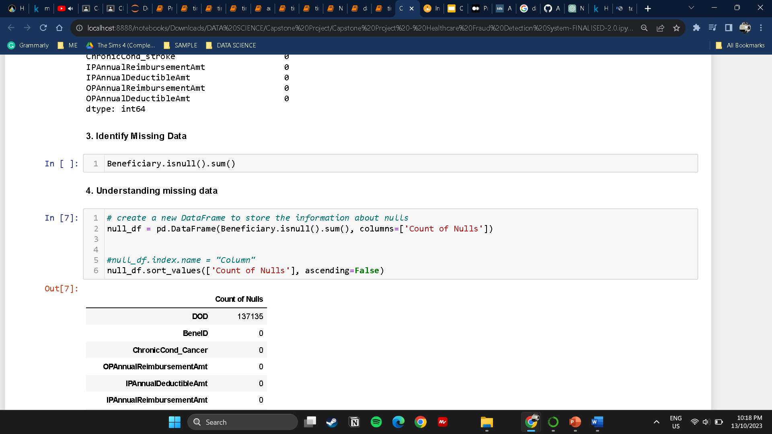
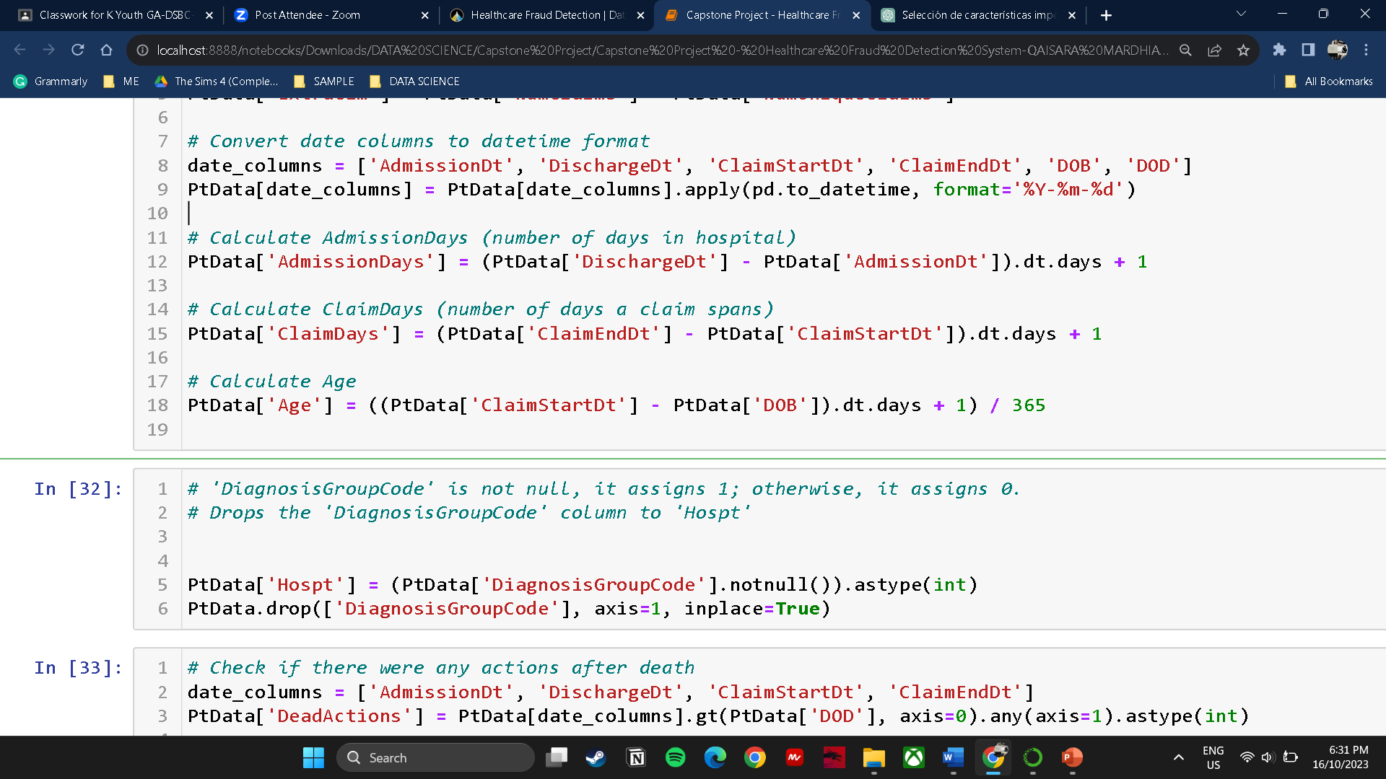
DATA GATHER & PREPARATIONS
Data Cleaning
Data Cleaning
Mercury is the closest planet to the Sun and the smallest one
Venus has a beautiful name and is the second planet from the Sun

Slide 4
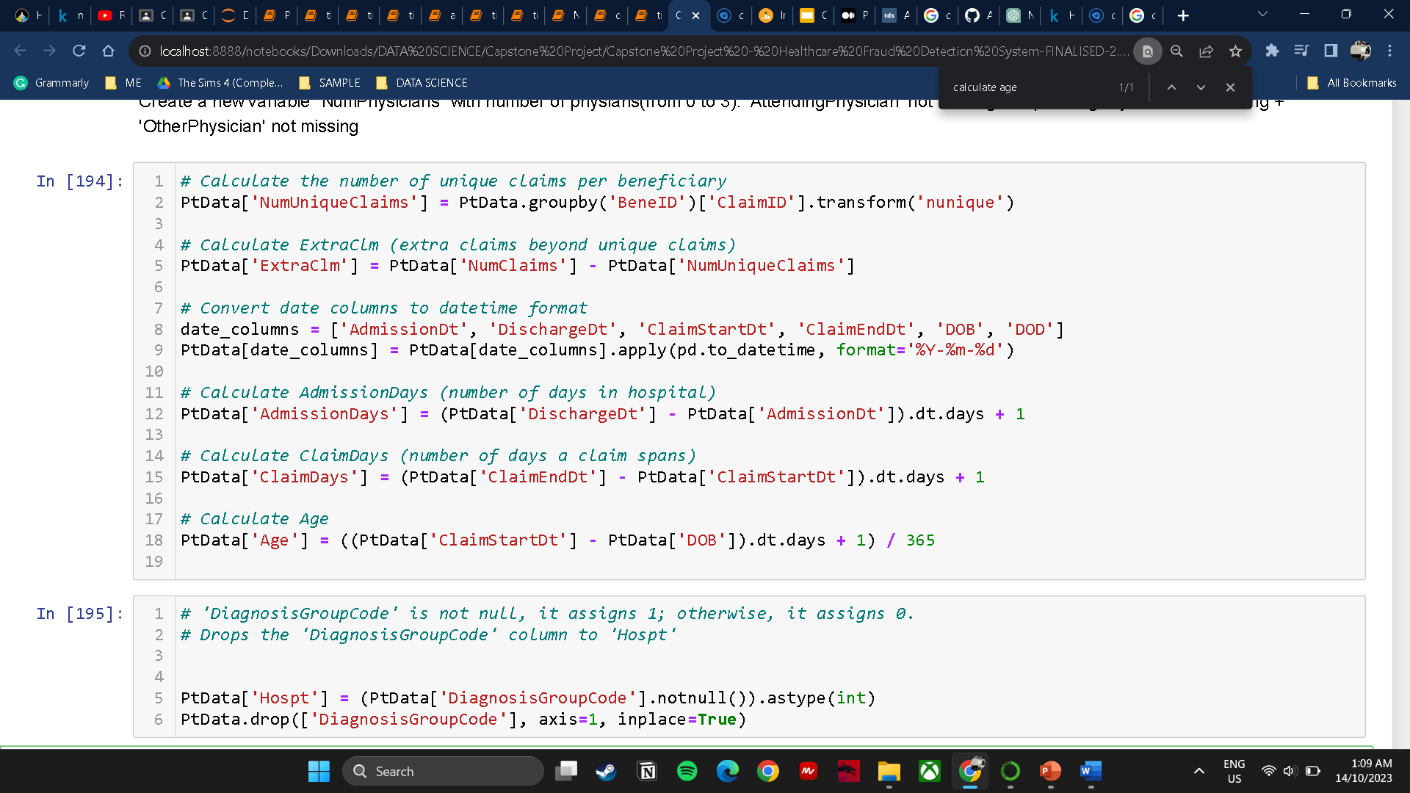
DATA PREPARATION
Number of Unique Claims per Beneficiary
Identify unusual claim pattern
Create a feature for the model
Claim Days
Unusual long or short claim durations can be indicative of potential fraud
Age
Detecting age inconsistencies between the reported age and the DOB
Notes:
The first variable is the "Number of Unique Claims per Beneficiary." To calculate this, I grouped the dataset by both 'BeneID' and 'ClaimID' and counted the unique values in the 'ClaimID' column within each group. The 'transform' function ensures that this count is applied to each row within its respective group. The variable 'NumUniqueClaims' is created to provide a feature for the models, aiding in differentiating between fraud and non-fraud cases.
The second variable pertains to "Claim Days." This variable is calculated to provide information about the duration of claims, which is relevant for identifying irregularities in claim patterns. Unusually long durations of claims may raise suspicion, as they could indicate fraud through overbilling.
The third variable relates to "Age." It is used to detect inconsistencies between the reported age and the Date of Birth (DOB) in the dataset. This helps identify any age-related discrepancies that may be indicative of fraud activity.

Slide 5
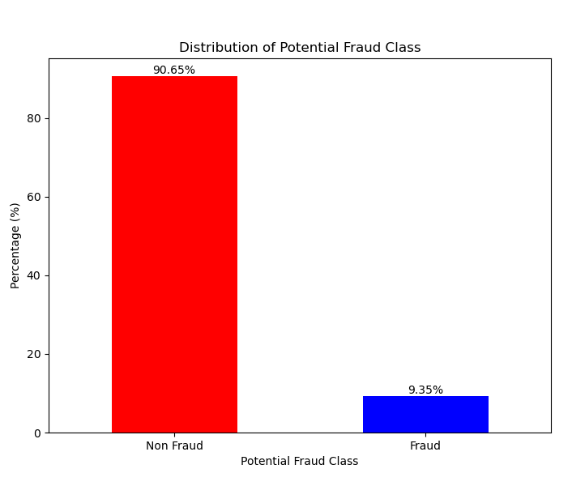
EDA
Bar plot highlights class distribution in the dataset.
Demonstrates substantial class imbalance in fraud detection data.
About 90.65% of data labeled as ‘Non-Fraud.’
The 'Fraud' class constitutes a smaller portion, around 9.35% of the dataset.
Notes:
First EDA - Class Distribution:
The initial EDA focuses on the distribution of the potential fraud class within the dataset. A bar plot is utilized to illustrate the class distribution. It clearly demonstrates a significant class imbalance in the fraud detection data. Approximately 90.65% of the data is labeled as 'Non-Fraud,' while the 'Fraud' class comprises a smaller portion, approximately 9.35% of the dataset. This class imbalance is a critical observation as it may lead to a bias toward the majority class, rendering the detection of the fraud class less effective. Therefore, a suitable model technique to address this imbalance is linear regression, which is commonly used for binary classification with imbalanced data.

Slide 6
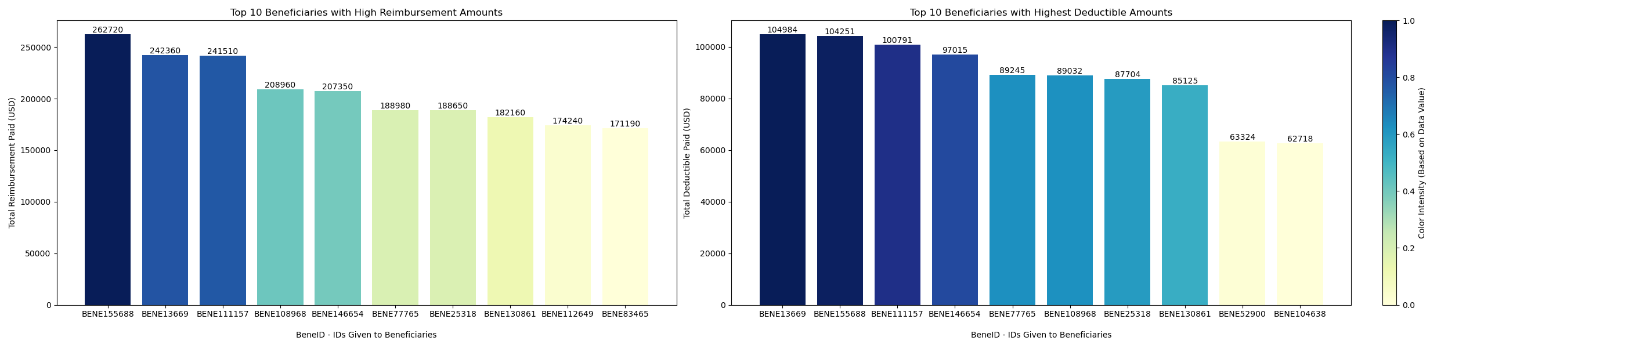
EDA
Mismatch between deductible and reimbursement amounts may suggest potential fraud.
BENE155688, with a reimbursement of $262,720 and a much lower deductible of $104,251.
This substantial imbalance raises concerns and merits further investigation as a possible red flag for fraud activity.
Notes:
Second EDA - Mismatch Between Deductible and Reimbursement:
The second EDA involves examining discrepancies between deductible and reimbursement amounts, which could potentially indicate fraud. For instance, take the case of 'BENE155688,' where the reimbursement amount is $262,720, significantly higher than the deductible of $104,251. This substantial imbalance raises concerns and warrants further investigation as a potential red flag for fraudulent activity. In this scenario, a suitable model for addressing such cases would be supervised learning for classification. The primary objective is to classify instances as fraud or non-fraud, and accuracy serves as a key metric for assessment. While linear regression is a valuable tool for prediction, it is not appropriate for classifying fraud and non-fraud cases in this context.

Slide 7
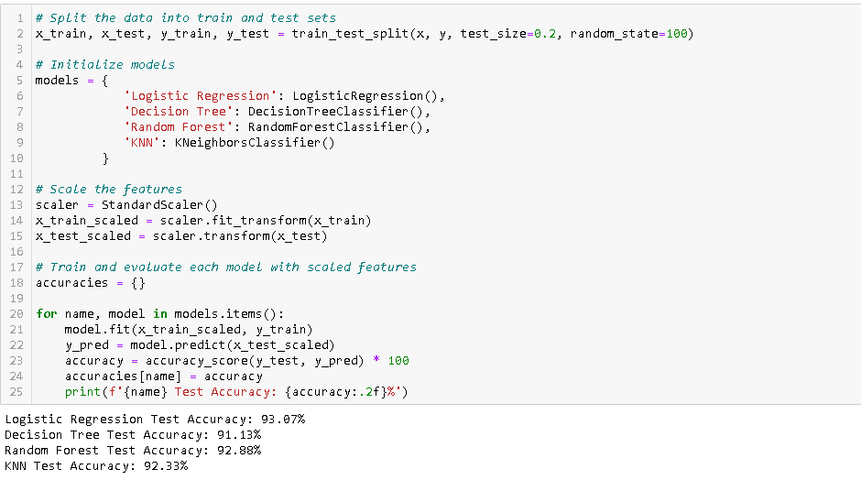
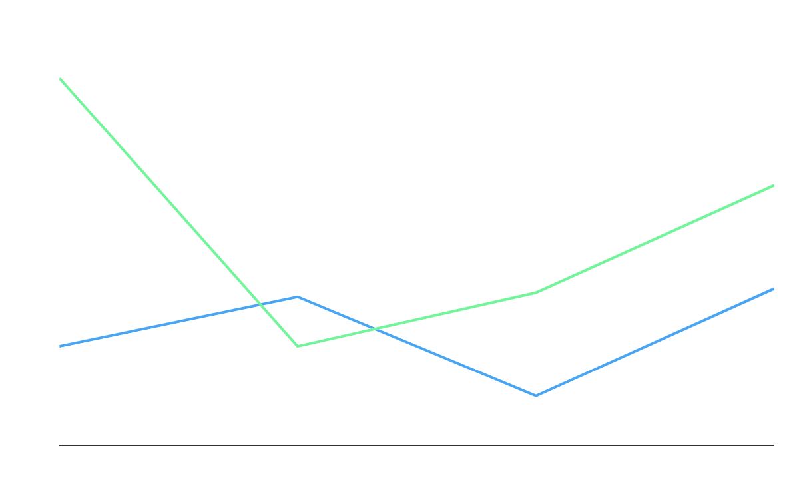
SUPERVISED LEARNING
Logistic Regression
used for binary classification, modeling the probability that a given input belongs to one of two classes
Random Forest
suitable for handling a large number of features to assess the importance of each feature.
Notes:
Supervised learning will be implemented in this project. Out of the logistic regression, k-nearest neighbors (KNN), and random forest models, the top two models with the highest accuracies will be selected. Following accuracy testing, it was found that logistic regression achieved the highest accuracy of 93.07%, followed by random forest with an accuracy of 92.88%.
Both the logistic regression and random forest models then go through permutation importance and feature importance analysis. From the resulting plots, the top three features were selected, and accuracy was recalculated. As a result, the accuracy for both models increased to 93.44% and 93.07%, respectively.

Slide 8
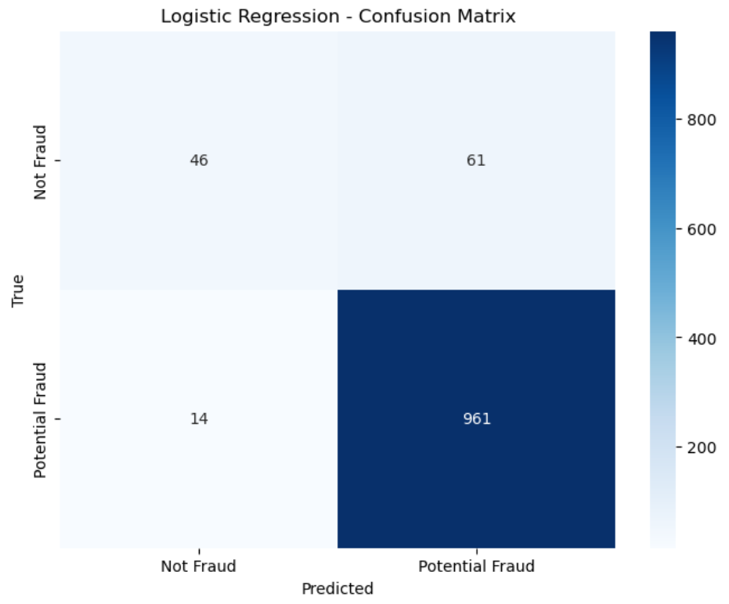
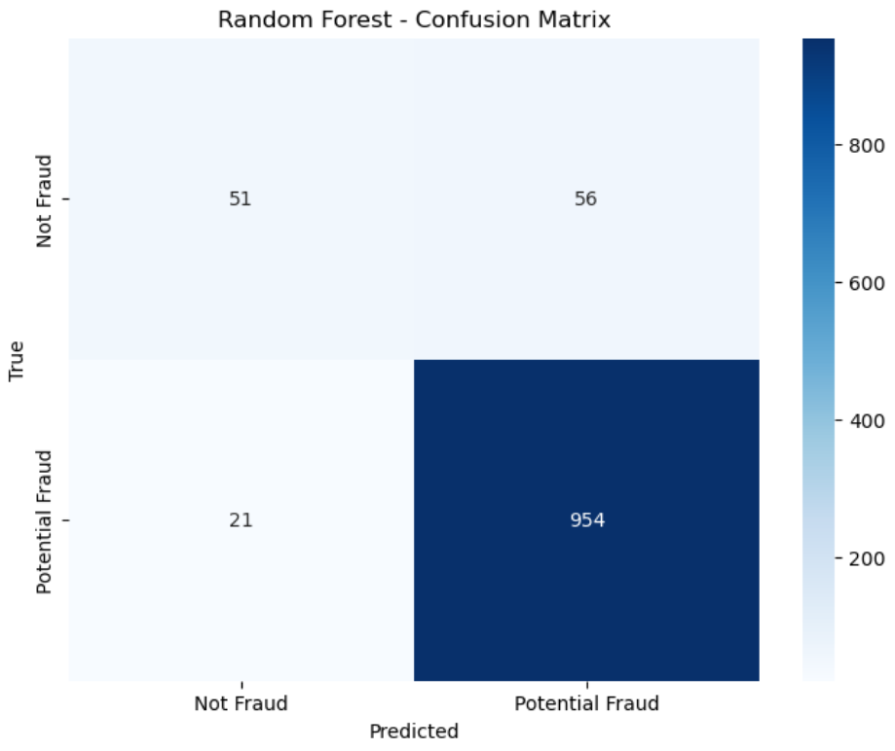
EVALUATION
Notes:
In imbalanced datasets, accuracy can be misleading because it often leans towards the majority class, where the data is most biased. As a result, accuracy tends to be high, even if the model is not effectively identifying the minority class (the imbalanced or rare class).

Slide 9
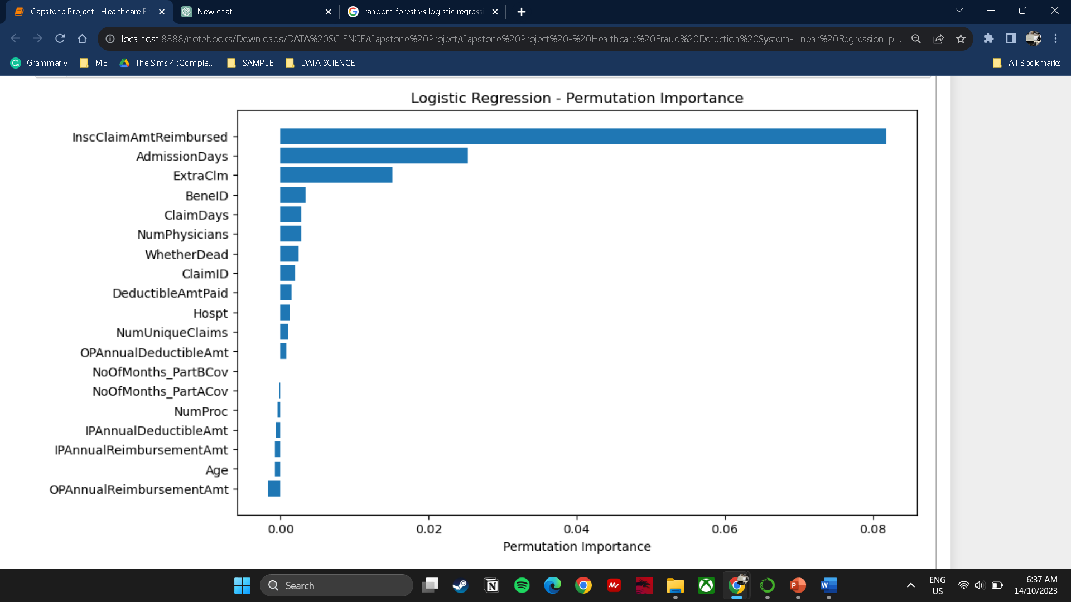
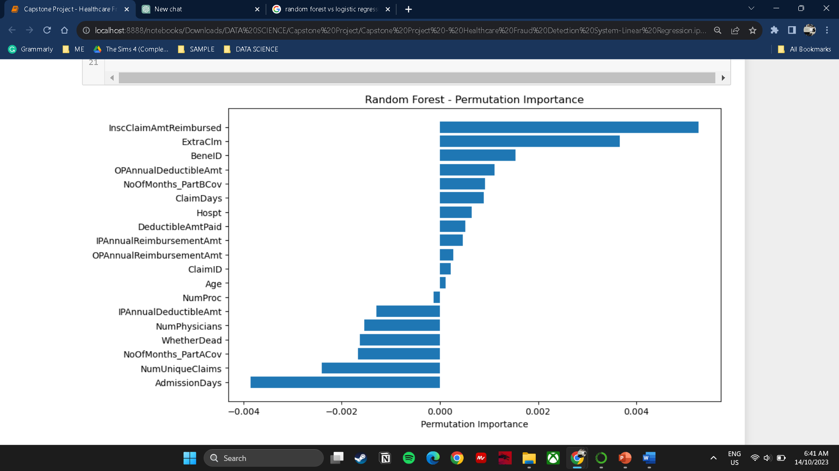
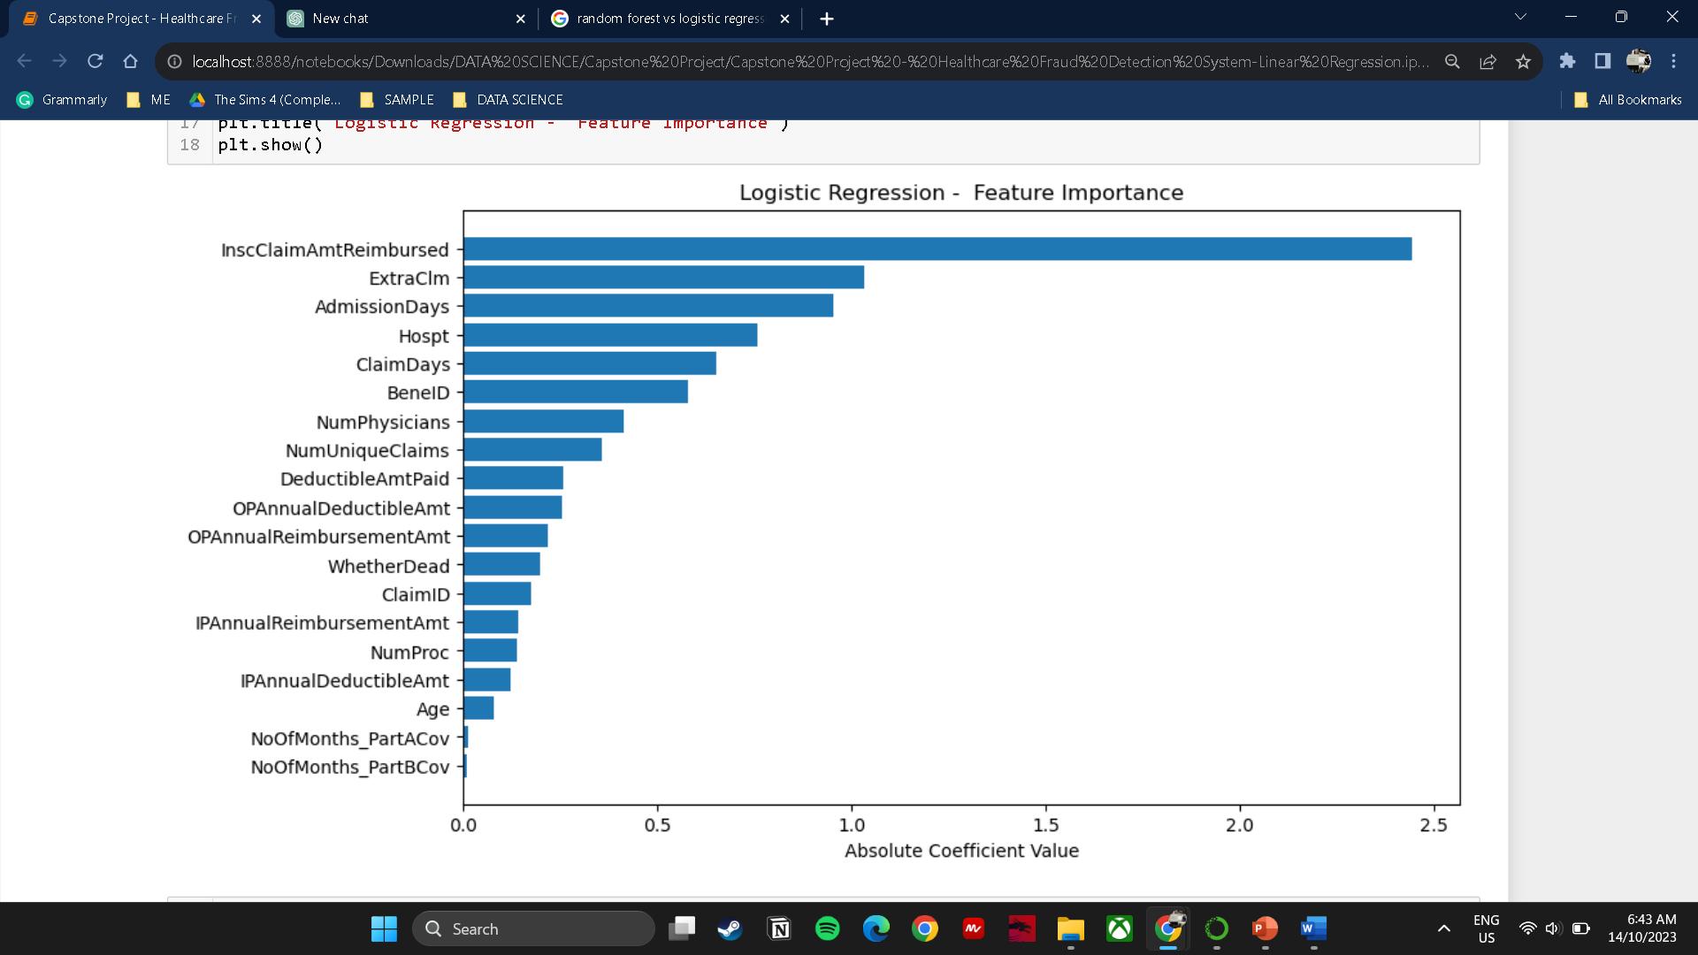
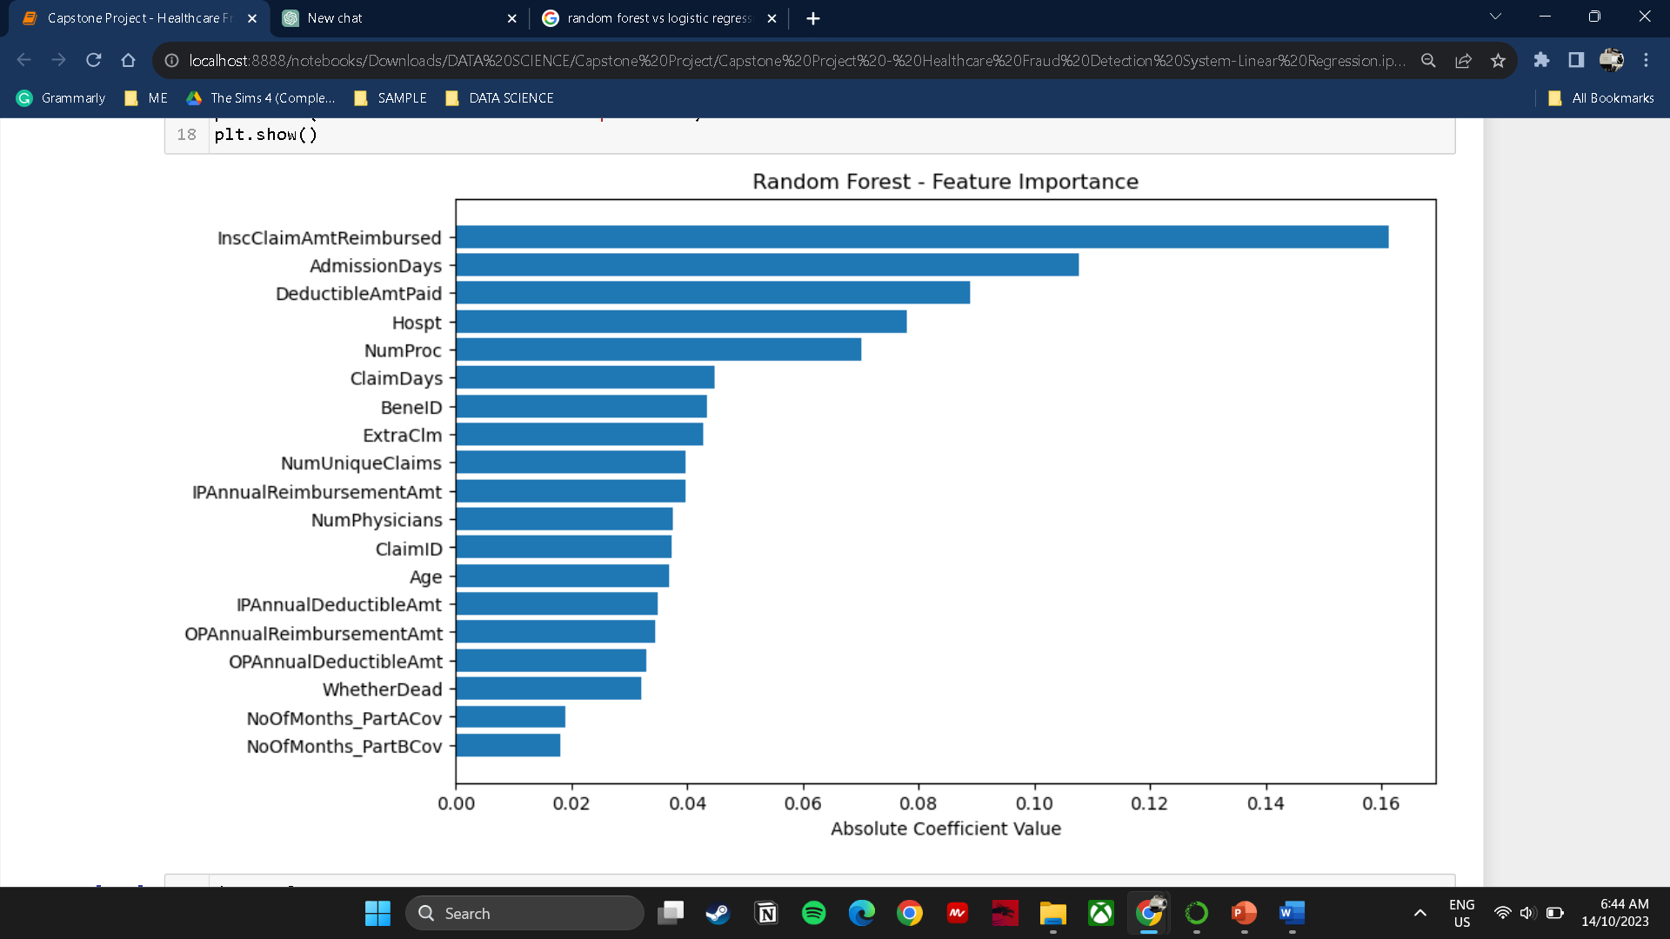
EVALUATION

Slide 10

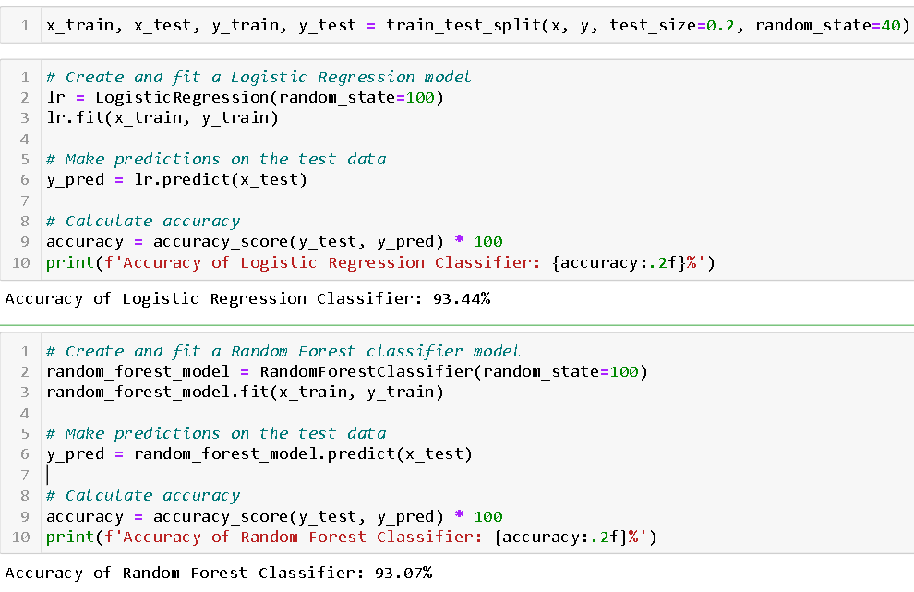
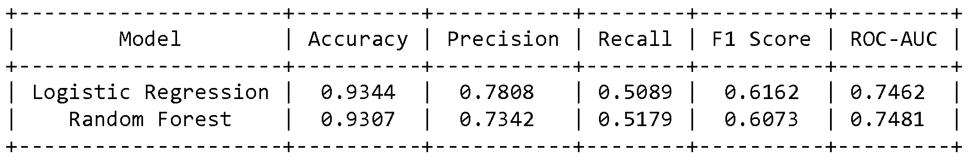
The top three features were selected, and accuracy was recalculated. As a result, the accuracy for both models increased to 93.44% and 93.07%, respectively
Notes:
ROC(Receiver Operating Characteristics)-AUC(Area Under the Curve) more robust metric in such cases because it focuses on the model's ability to distinguish between the two classes, regardless of their imbalance. A higher AUC indicates that the model is better at separating the classes.
Accuracy may appear high in imbalanced datasets due to its bias towards the majority class. However, AUC provides a better assessment of the models with imbalanced data.

Slide 11
RECOMMENDATION
Increasing the amount of fraud data in the training dataset is able to improve machine learning model performance. Balancing the dataset with a sufficient representation of both fraud and non-fraud data enhances the model's ability to accurately learn and distinguish fraud patterns

